Slide 1
Types of Meat
Beef- cattle over 1 year of age
Veal- meat from very young calves, usually less than 3 months of age
Mutton-older sheep over 1 year of age
Lamb- young sheep under 1 year of age
Chevon- meat from mature goats
Cabrito- meat from young goats
Variety Meats-organ meats including liver, kidney, heart, tongue, tripe (stomach), brains, sweetbreads (thymus gland)

Slide 2
Postmortem inspection
Routine postmortem examination of a carcass should be carried out as soon as possible after the completion of dressing in order to detect any abnormalities so that products only conditionally fit for human consumption are not passed as food. All organs and carcass portions should be kept together and correlated for inspection before they are remove from the slaughter floor
Postmortem inspection should provide necessary information for the scientific evaluation of pathological lesions of meat. Professional and technical knowledge must be fully utilized by:
viewing, incision, palpation and olfaction techniques.
classifying the lesions into one of two major categories - acute or chronic.
condition is localized or generalized, and the extent of systemic changes in other organs or tissues.
determine the significance of primary and systemic pathological lesions and their relevance to major organs and systems, particularly the liver, kidneys, heart, spleen and lymphatic system.
coordinating all the components of ante mortem and postmortem findings to make a final diagnosis.
submitting the samples to the laboratory for diagnostic support, if abattoir has holding and refrigeration facilities for carcasses under detention

Slide 3
Carcass Examine
General
examine carcasses (including musculature, exposed bones, joints, tendon sheaths etc.) to determine any signs of disease or defect. Attention should be paid to bodily condition, efficiency of bleeding, color, condition of serous membranes (pleura and peritoneum), cleanliness and presence of any unusual odours
Lymph nodes
Superficial inguinal (male)
Palpate Supramammary (female)
Palpate External and internal iliac
Palpate Prepectoral
Palpate Popliteal
Palpate (only sheep/goats and game/antelope) Renal
Palpate (cattle, horses, pigs) or incise if diseases is suspected.
Prescapular &prefemoral Palpate (only sheep and goats)

Slide 5
Carcass judgment
Localized conditions
Trimming or condemnation may involve:
Any portion of a carcass or a carcass that is abnormal or diseased
Any portion of a carcass affected with a condition that may present a hazard to human health
Any portion of a carcass or a carcass that may be repulsive to the consumer
Generalized lesions usually require more severe judgment than localized lesions

Slide 6
Quality Grading
Maturity
Bone development
Button formation (ossification)
Whiter and flatter rib bones
A (youngest) -------E (oldest)

Slide 7
Appearance of Ribs
A- Narrow and oval
B- Slightly wide and slightly flat
C- Slightly wide and moderately
flat
D- Moderately wide and flat
E- Wide and flat

Slide 8
Maturity cont’d.
A
B
C
D
E
9-30 months
30-42 months
42-72 months
72-96 months
> 96 months

Slide 9
There are 8 primal cuts according to the National Livestock and Meat Board
Eight Primal Cuts of Beef:
chuck
rib
short loin
sirloin
round
brisket/shank
short plate
flank

Slide 10
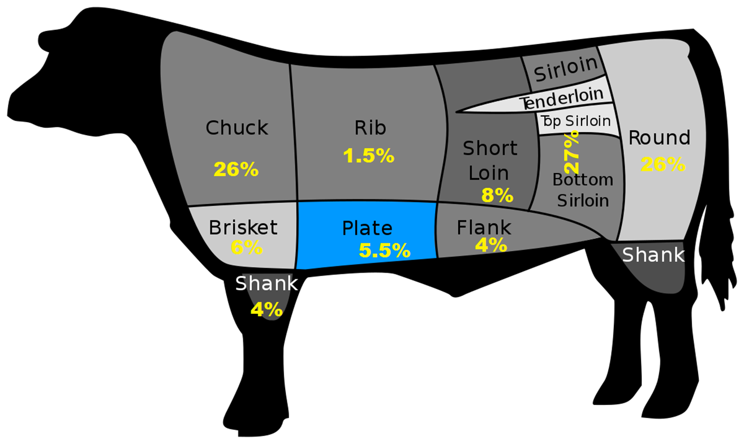
Muscle composition Why some cuts tender and some are tough.
Notes:
Meat from furred animals consists of edible lean muscular tissue, connective tissue which is primarily protein based but too tough to be edible, fat, and bones.
The carcass is divided up into large manageable pieces called primal cuts. The primal cuts are based on musculature and location. Primal cuts are very rarely cooked whole; rather, they are cut into smaller cuts called Sub-primal cuts. These cuts in turn are cut into even smaller, more manageable portions called fabricated cuts. These are represented by steaks, chops, stew meat, etc.

Slide 11
How can you tell a tender cut from a tough one before cooking?
Location on carcass dictates tough or tenderness from actual muscle usage.
Length of fibers
short= tender
long and stringy=tough
Amount of intramuscular fat or marbling.

Slide 12
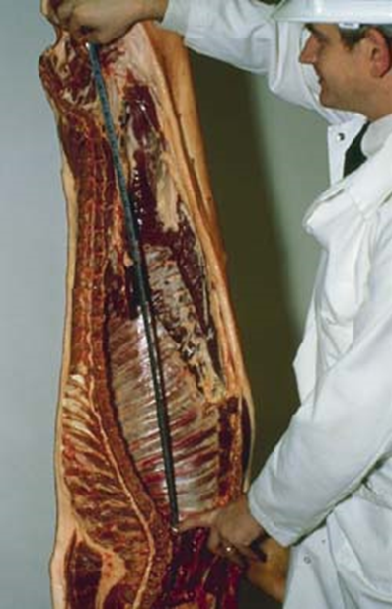
Types of Inspection and Tags
Postmortem Inspection – After death
Inspected and Passed
Good for consumption as a raw product
Condemned
Whole carcass or parts are tanked
Retained
Railed off for more inspection
Passed for cooking
Re-inspect and if acceptable must be cooked prior to shipment
Re-inspection
Any product at any time can be re-inspected
Safety net for strange occurrences

